Slide 1
3 Step Studio Block Coding Solution
Process of Presentation
Overview of Editor
Quick Code Example and Process
Snap shot of all/most code blocks
Review of all Editors Pros and Cons
Example of Block Coding for 3 Step Studio

Slide 2
Game Maker
Icon/Tile based system
Drag and drop
Different shaped Icons
Set
Check/Test
Draw
Event and Action based
Can create custom scripts
Code must be created on an object
Very easy to understand and pickup

Slide 3
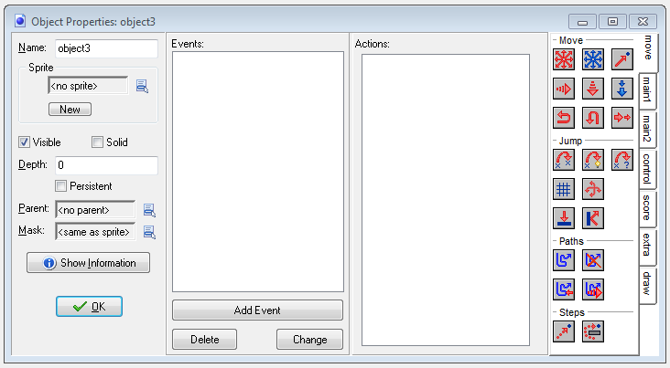

Slide 4
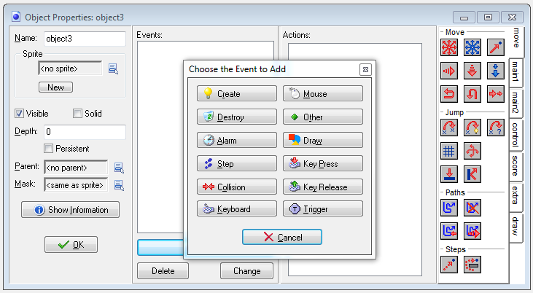

Slide 5
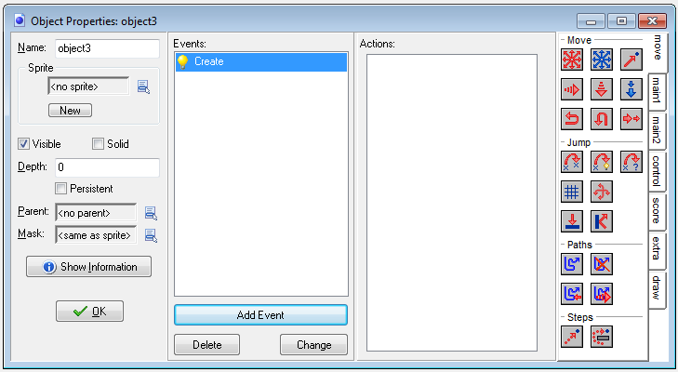

Slide 6
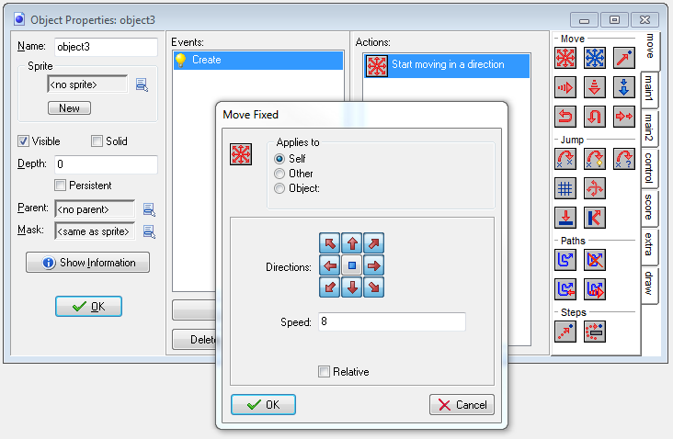

Slide 7
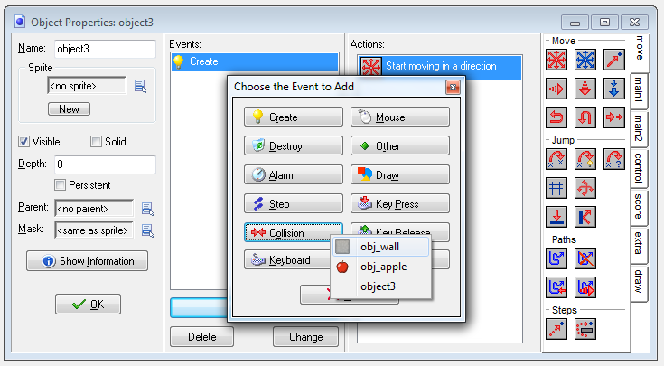

Slide 8
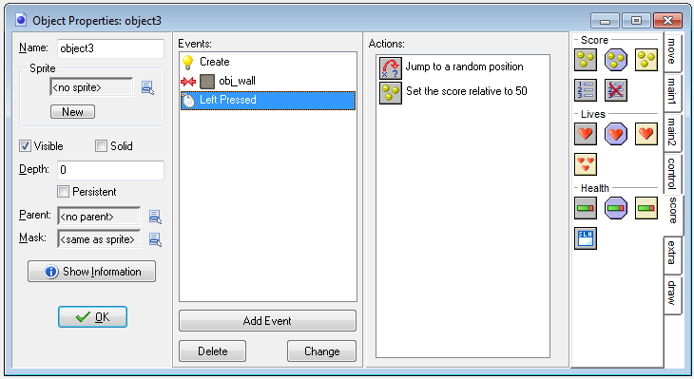

Slide 9
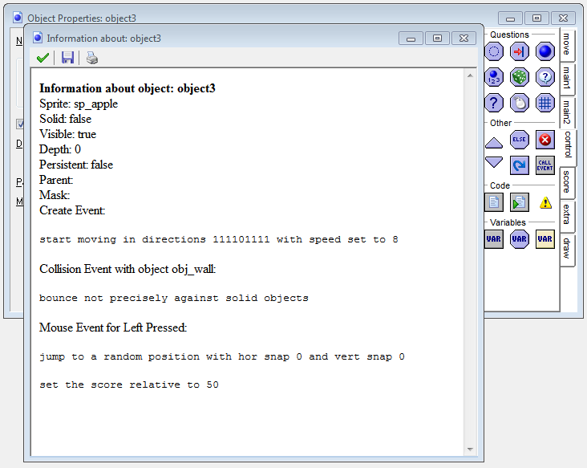

Slide 10
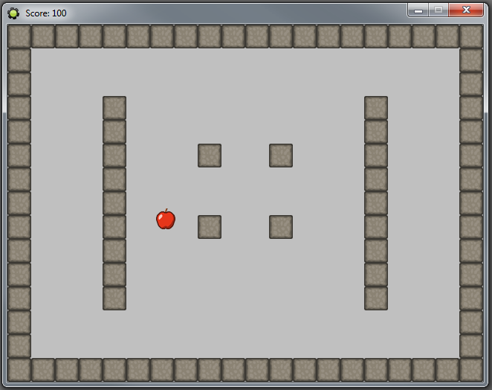

Slide 11
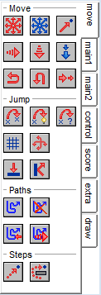
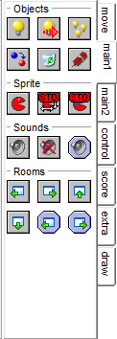
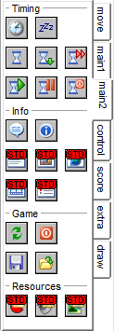
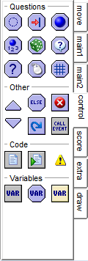
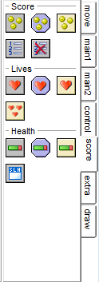
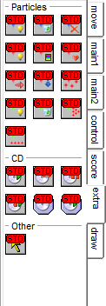
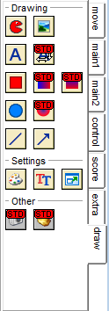
Game Maker 132

Slide 12
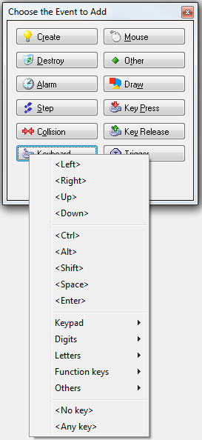
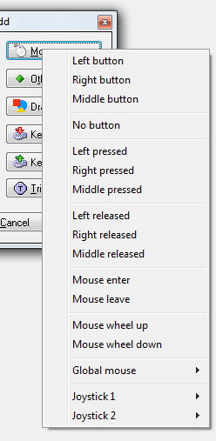
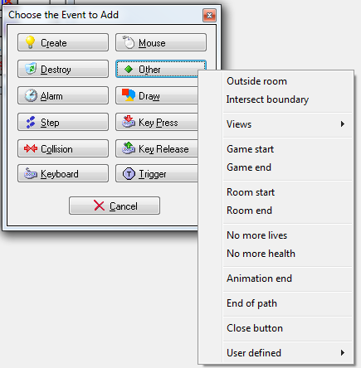
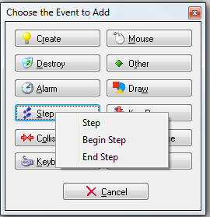

Slide 13

GameSalad
Drag and drop Behavior tiles
Can place tiles within tiles
Code must be placed on Actors
Not able to create custom scripts
Very easy to understand and pickup
Conner Haines is not the typical eleven year boy. In rural Pennsylvania, Conner Haines spends his free time developing apps with GameSalad. Better yet, he spends his time and app development skills by offering app development services for free to any child (ages 5-12) with cancer.

Slide 15
38 GameSalad
132 Game Maker

Slide 22
Stencyl
Based off the tile system from Scratch
Multiple different tiles for the type
Able to place tiles within tiles
Tiles snap together
Can create simple custom scripts for objects or scenes
Able to create fully custom script for the game as a whole, not object or scene based
Very powerful but not the easiest to pickup

Slide 23
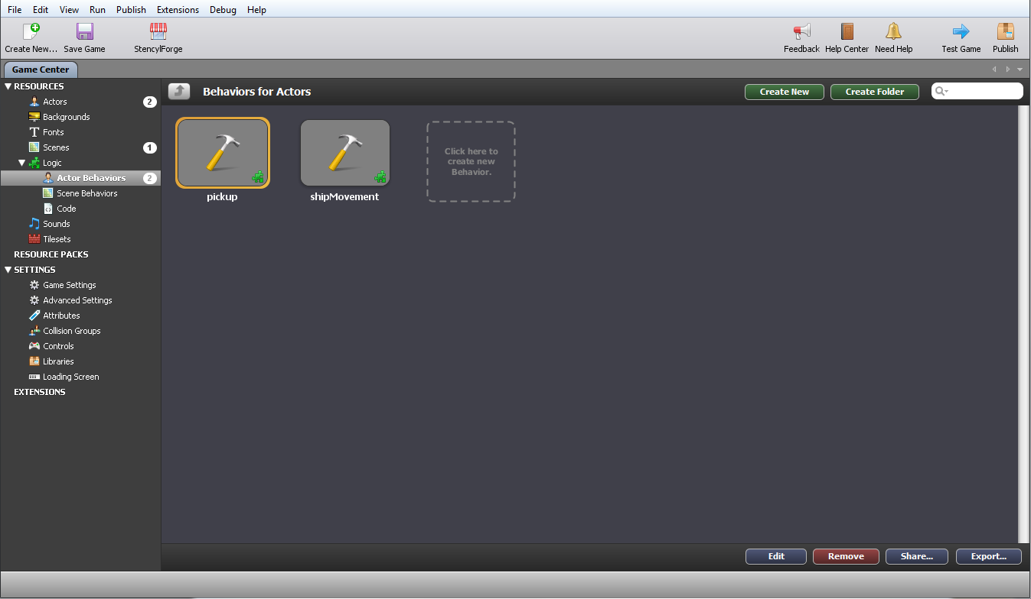

Slide 24
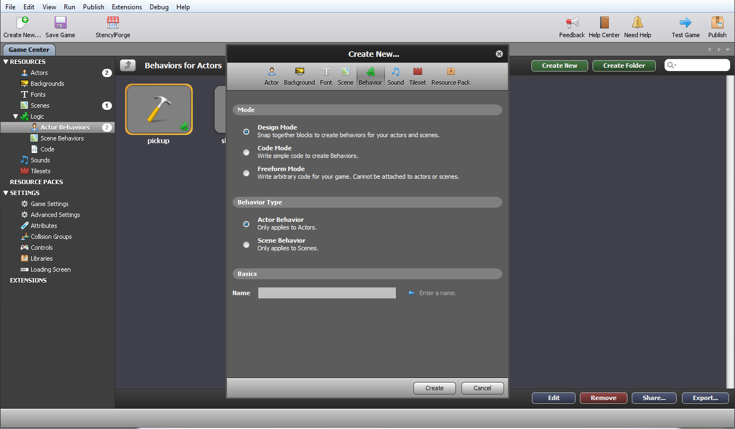

Slide 25
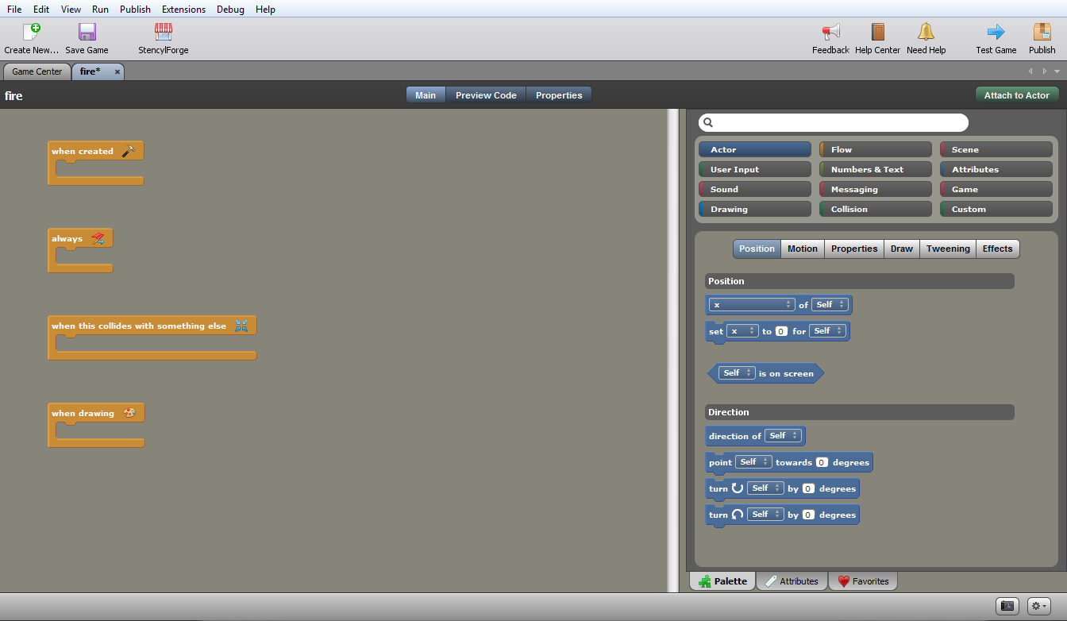

Slide 26
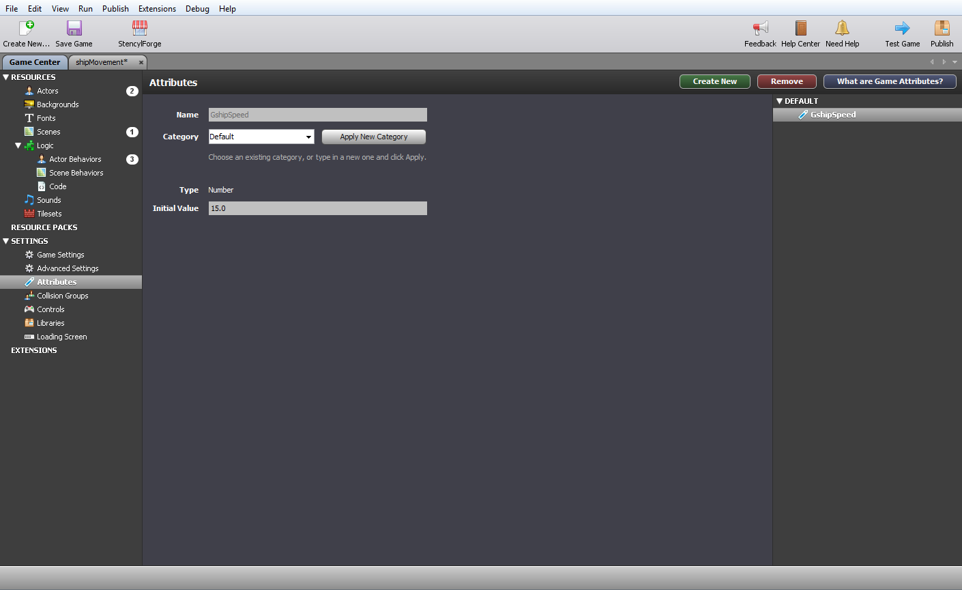

Slide 27
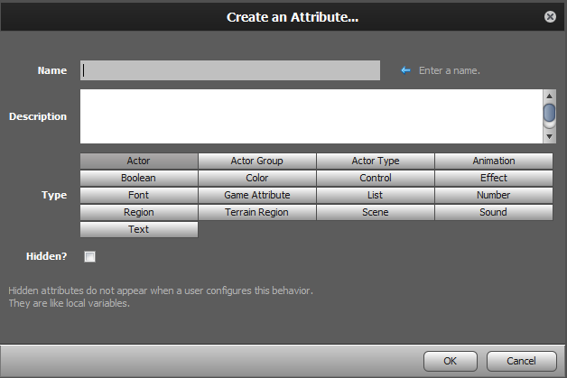

Slide 28
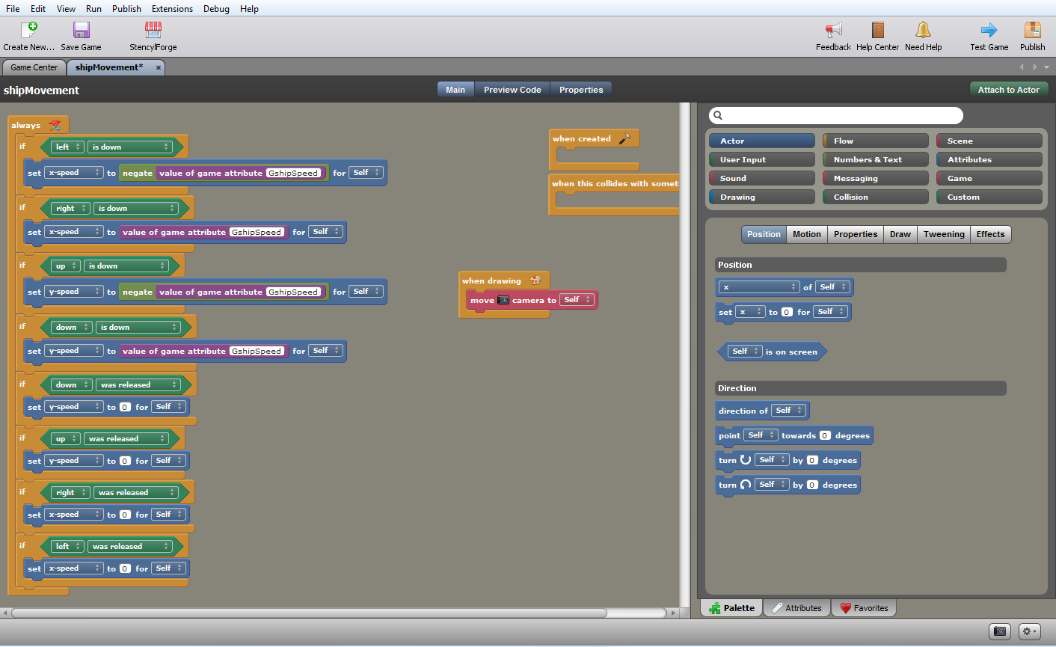

Slide 29
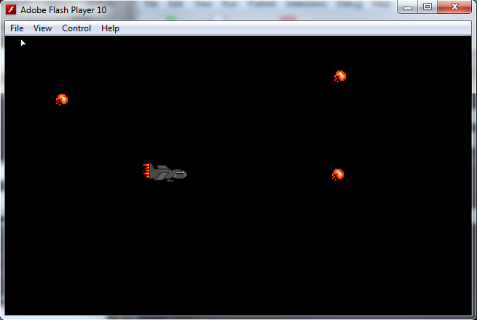

Slide 30
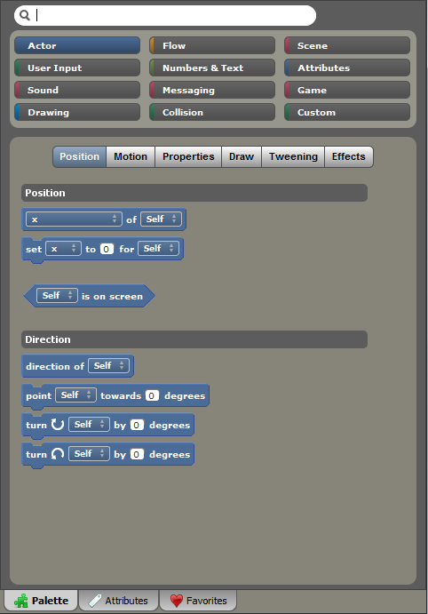
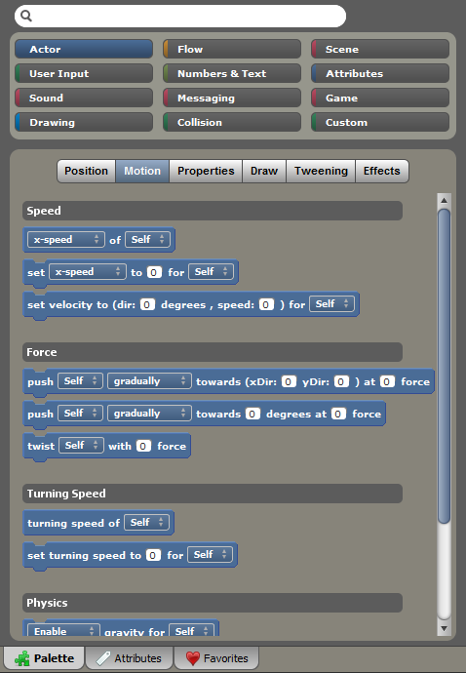

Slide 31
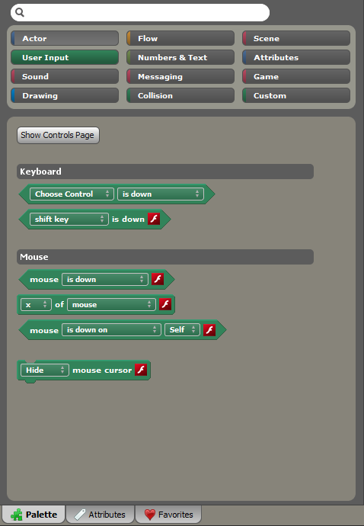
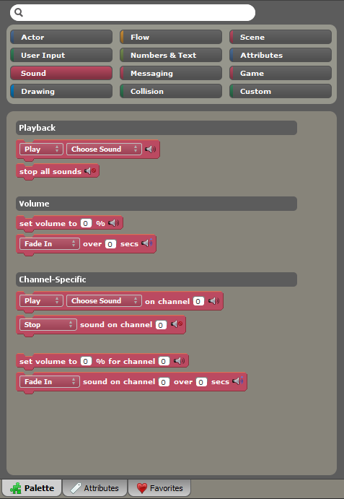

Slide 32
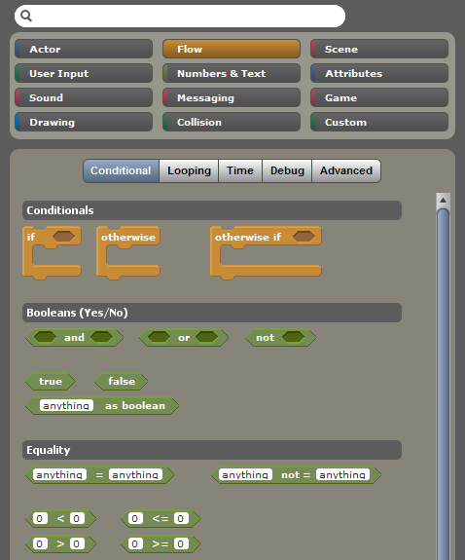
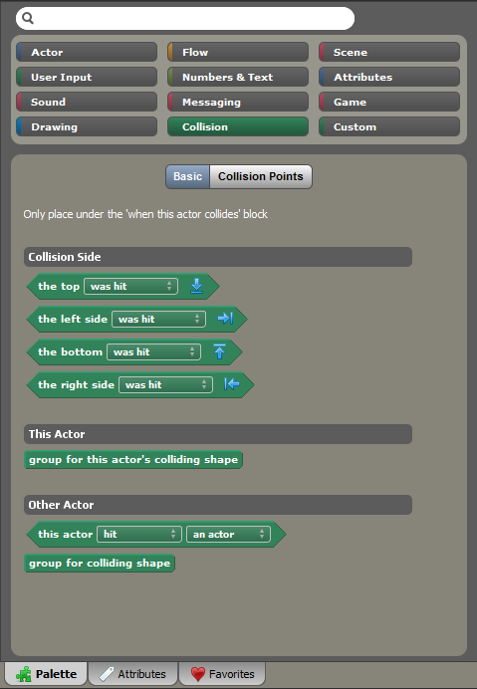
38 GameSalad
132 Game Maker
289 Stencyl

Slide 33
Construct 2
Event and Action based
Multiple Dialog Walkthrough
Code must be created on an object
Lots of text input
Not able to create custom scripts
Not very easy to use or pickup

Slide 34


Slide 35
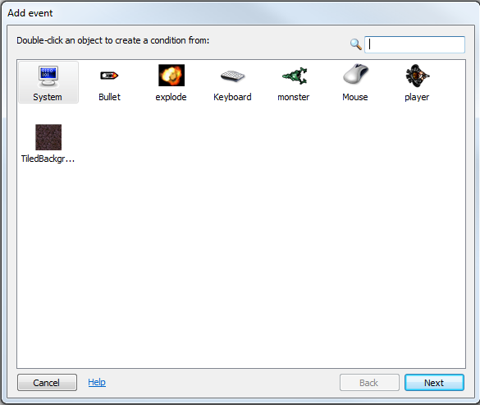

Slide 36
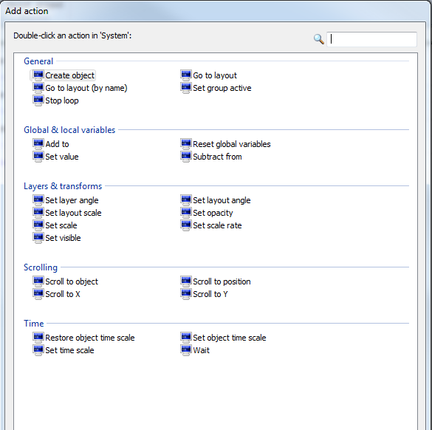
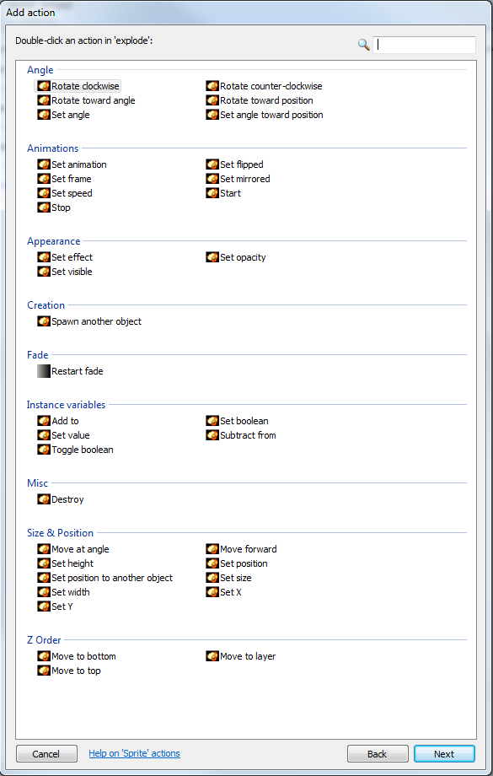

Slide 37
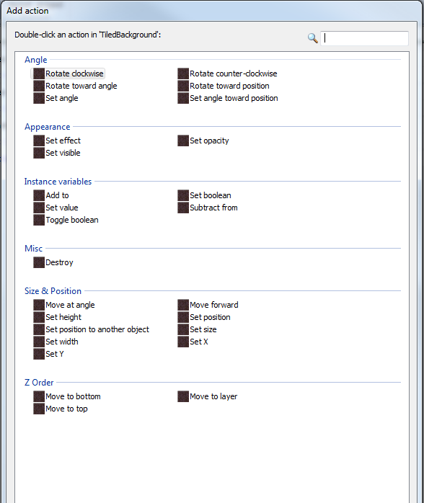
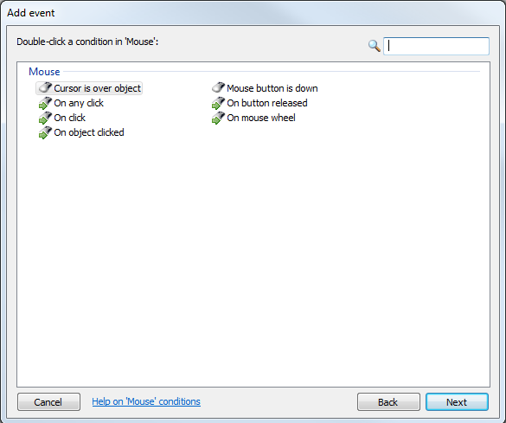

Slide 38
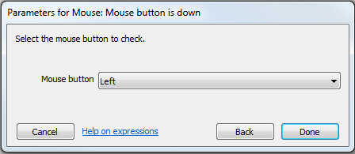
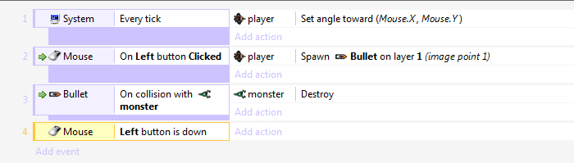

Slide 39
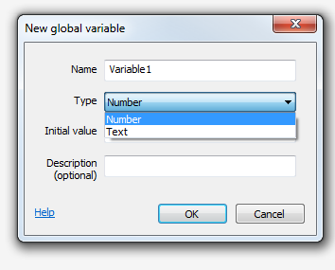
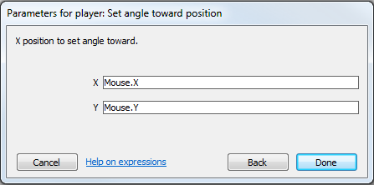
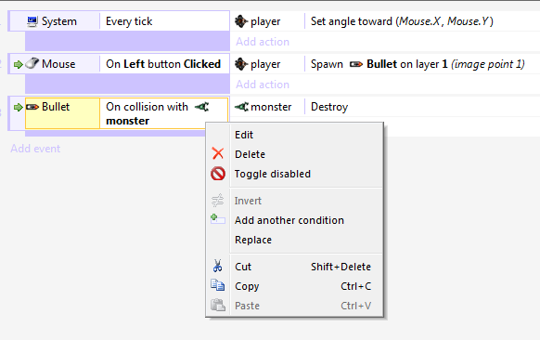
38 GameSalad
132 Game Maker
289 Stencyl
~160 Construct 2

Slide 40
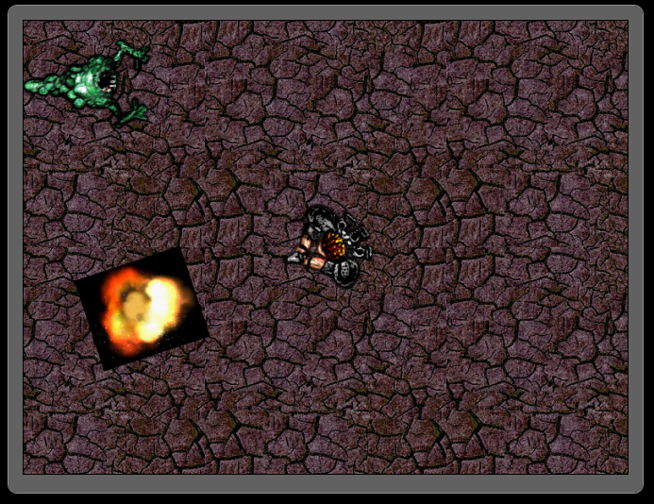

Slide 41
Results
Almost all code needed to be created on an Object or Actor
All except Construct 2 were some form of Tile Based programming
From using all 4, Game Maker and GameSalad were the easiest to pick up, understand and remember
Stencyl is great and more complex, but a pain to find what you need, even with the search function
Construct 2 needs help with everything
End Result, recommend a mix of Game Maker and GameSalad style programming

Slide 42
Example of Block Coder for 3 Step Studio – code name Stepper

Slide 43
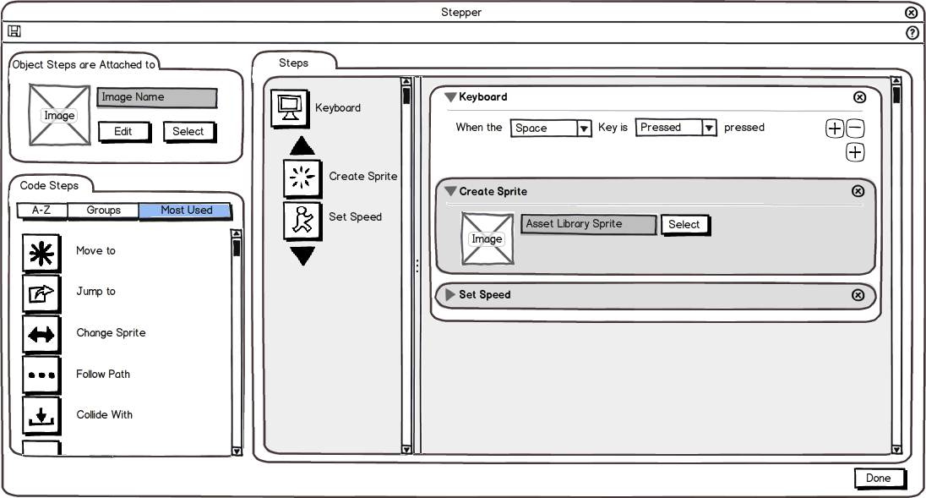

Slide 44
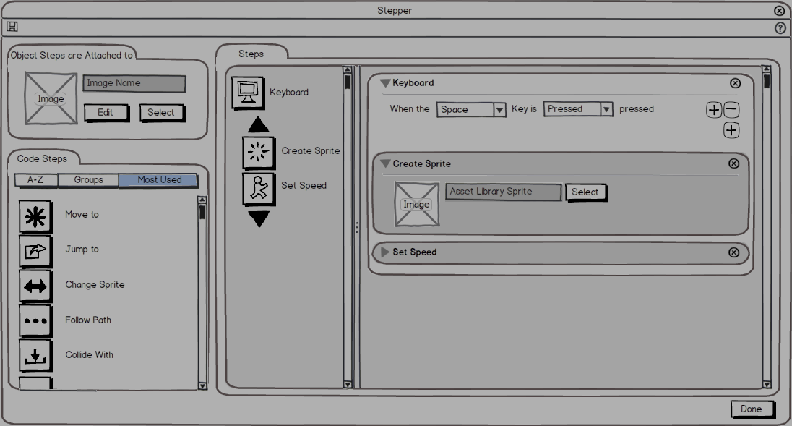


Slide 45
